Slide 1






ETL 3 :
Real Time interaction
Laura Belmond - Solution Engineer

Slide 2
TABLE
OF CONTENT
Introduction : a lot of code today
What is kafka ?
How to integrate it ?
Team work

Slide 3
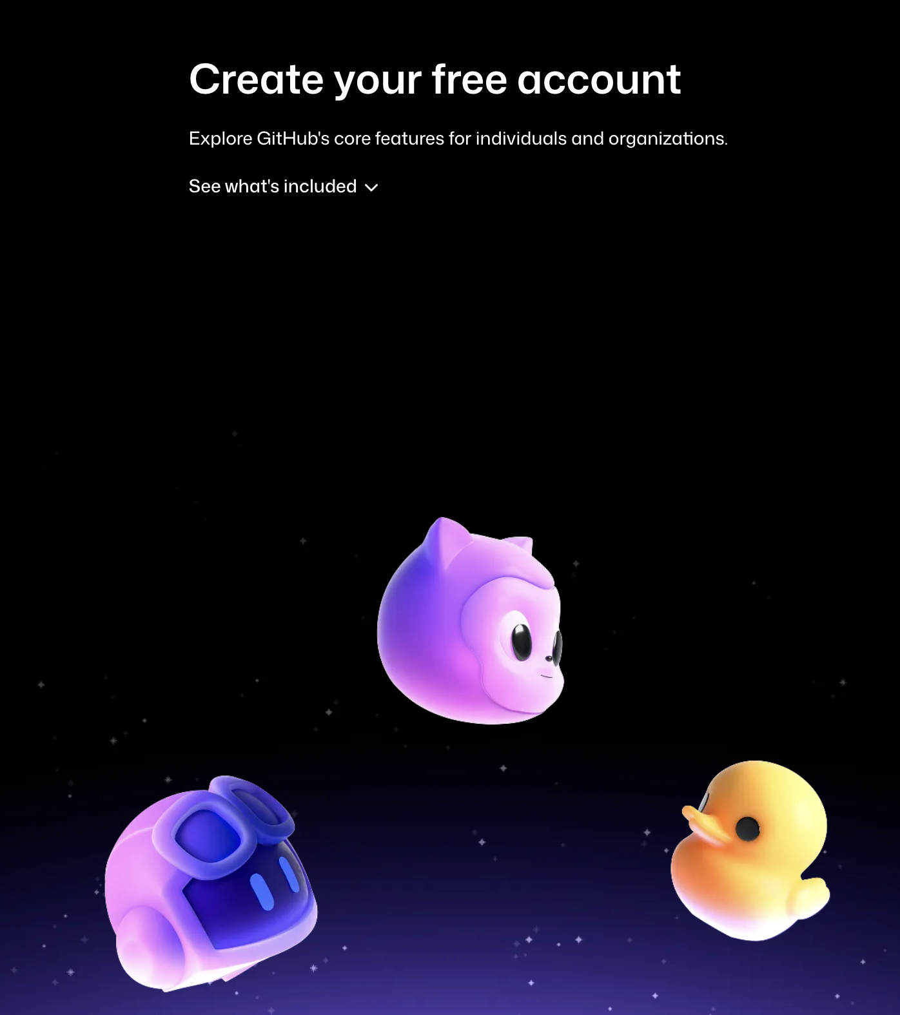
Today Deliverables : Real time streaming
-Git Hub Repo for real time ingestion
(Do it by group, but everyone submit a link and create his GIT )
The repo must be public so I can check it
-Several level : you need to Submit the snowpipe ingestion
(SNOWPIPE TUTORIAL). The rest is optional .You can then try
the SIMPLE KAFKA_TUTO (without docker)
KAFKA_TUTORIAL is a bit harder (use docker)
-From now on, all of the session assignment will have a deadline for Saturday

Slide 4
Groupe project : what is expected
ORAL
WRITTEN
-Everyone in a group has a role (CIO, Data eng… be creative).
-15 minutes of presentation with :
Introduction to the company and the use case
Presentation of the role in the team
Presentation of the data pipeline (architecture)
Demo of the pipeline (generating data)
Dashboard / Streamlit application to monitor the pipeline
Dashboard / Streamlit application to visualize the data
Conclusion
Jury : Me + a Data engineer
-Repo
-Slides
-Create a user for me in your snowflake environment

Slide 5
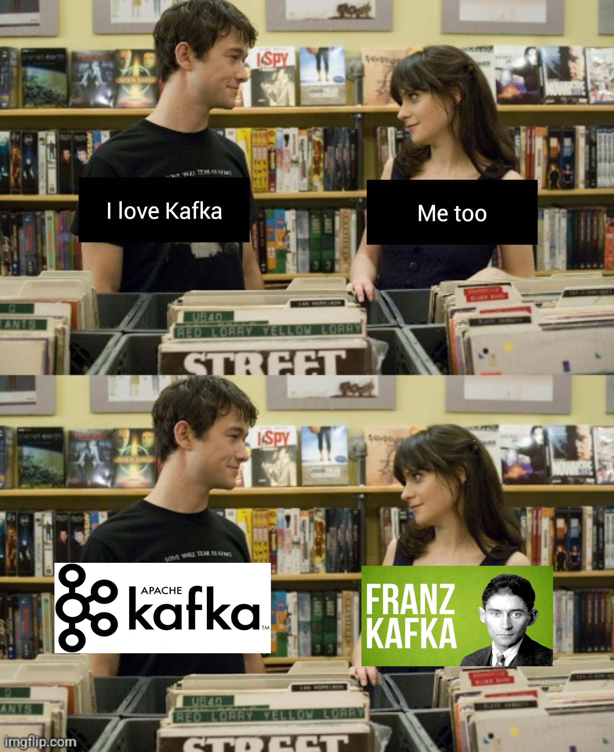
Kafka is everywhere

Slide 6
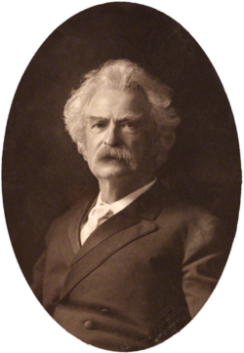
Building a real time Data Pipeline, why it matters ?
What is real time ?
What applications need it ?
Maintenance & failures ?

Slide 7
TABLE
OF CONTENT
Introduction : a lot of code today
What is kafka ?
How to integrate it ?
Team work

Slide 8


Understand the transition from Batch to Streaming and the role of Kafka

Slide 9
Batch Processing (photo): Data is collected and processed in large chunks at scheduled intervals (like we have done on Monday).
Latency: can be high.
Use Cases: Monthly reporting, payroll, traditional warehousing…
Streaming Processing (camera): Data is processed continuously as individual records, immediately after being generated.
Latency: Low (milliseconds to seconds).
Use Cases: Real-time dashboards, fraud detection, personalized recommendations…

Slide 10
Data streaming
What is Data Streaming?
Definition: Data streaming is the process of transmitting continuous flows of data records (events) from sources to destinations without storing them indefinitely in intermediate databases.
Data as Events: In streaming, data is seen as a sequence of discrete, time-stamped events (remember the camera example).
Contrast with Batch: Batch moves files; Streaming moves a continuous sequence of records.

Slide 11
Why Real time matter
Operational Agility: Allows businesses to react to events instantly (stopping a fraudulent transaction).
Enhanced Customer Experience: Enabling instant personalization (recommending a product immediately after a click).
IoT & Sensors: Essential for handling the massive velocity and volume of data generated by connected devices and manufacturing sensors

Slide 12

Story time : Apache
The Apache Software Foundation (ASF) is a non-profit organization that supports open-source software projects.
When a tool is "Apache," it implies it is mature, community-driven, open-source, and not owned by a single corporation.
a 'patchy' server

Slide 13
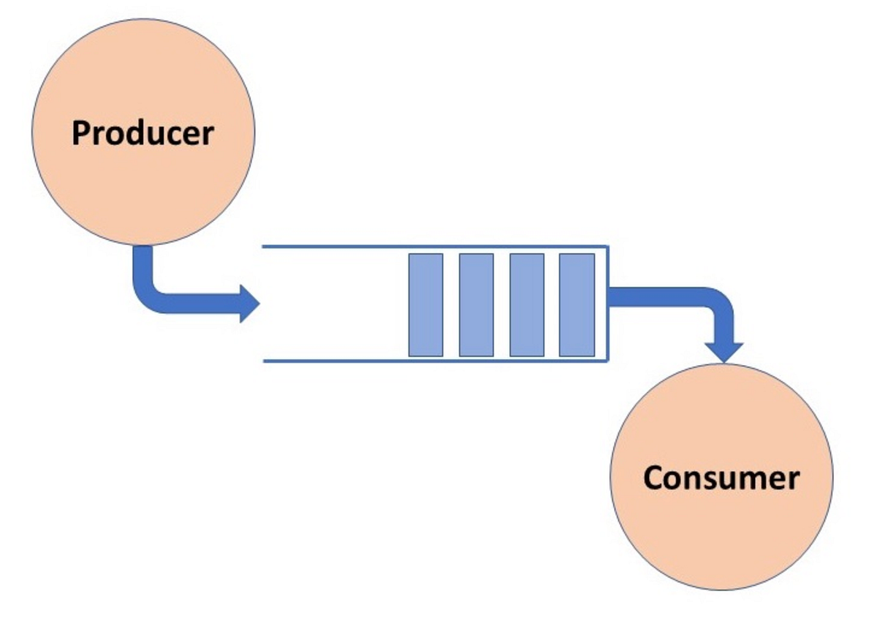
Definition
Producers
Definition: Applications that publish (write) events to a Kafka Topic.
Key Function: Producers automatically decide which Partition to write to, usually based on the message key (ensuring all events for one user go to the same partition).
Consumers
Definition: Applications that subscribe to (read) events from a Kafka Topic.
Consumer Groups: Consumers typically operate within a Consumer Group to enable parallel reading.

Slide 14
Events
Definition: An Event represents a historical fact or state change that happened at a specific point in time.
Structure: Typically structured data composed of three parts:
Key (Optional): Used for partitioning (e.g., user_id).
Value (Payload): The actual data (e.g., {"action": "click"}).
Timestamp: The time the event occurred.

Slide 15
Topics
Definition: Topics are categories or feeds to which records (events) are published.
Analogy: Think of a Topic as a folder in a file system, or a table in a database, where messages of a similar type are grouped.
Consumer Subscription: Consumers subscribe to one or more Topics to receive data streams.

Slide 16
Partitions
Definition: A Topic is divided into multiple Partitions.
Why Partition? This is the key to Kafka's scalability and parallelism.
Mechanism: Partitions are spread across different broker servers, allowing multiple consumers to read data from the same topic concurrently.

Slide 17

Analogy

Slide 18
Other definitions
Kafka's Core Philosophy : The Commit Log
Concept: Kafka is fundamentally a distributed commit log (or transaction log).
How it Works: All events are appended to the log in the order they arrive. Once written, events are immutable and cannot be changed.
Durability: Data persists on disk for a configurable period, allowing consumers to catch up even if they go offline.
Brokers (Cluster -> bunch of brokers)
Definition: The Kafka server(s) that run the Kafka service. A Kafka cluster consists of multiple brokers.
Role: Brokers receive messages from Producers, store them on disk, and serve them to Consumers.
Replication Factor: Data is replicated across multiple brokers to ensure fault tolerance. If one broker fails, data remains accessible.
Offset
Definition: A unique, sequential ID given to each event within a Partition.
Role: The Offset is the pointer that tells a Consumer exactly which message was last read.
Control: Consumers explicitly manage their offsets, offering flexible consumption patterns (e.g., reading the newest data, or re-reading historical data).
Kafka Connect
Definition: A framework for connecting Kafka with external systems (databases, file systems, APIs) for easy data integration.
Connectors: Used to automatically import data from sources (Source Connectors) or export data to sinks (Sink Connectors).
Kafka Streams
Definition: A client library for building applications and microservices that process and analyze data stored in Kafka in a stateful and distributed manner.
Function: Enables complex transformations and joins directly on the stream (Stream Processing).
Zookeeper / KRaft (depend of kafka version)
Historical Role (Zookeeper): Traditionally managed the Kafka cluster state, configuration, and coordination of brokers.
Modern Shift (KRaft): Kafka is transitioning away from Zookeeper to KRaft (Kafka Raft), an internal protocol for metadata management, simplifying deployment and improving scalability.

Slide 19
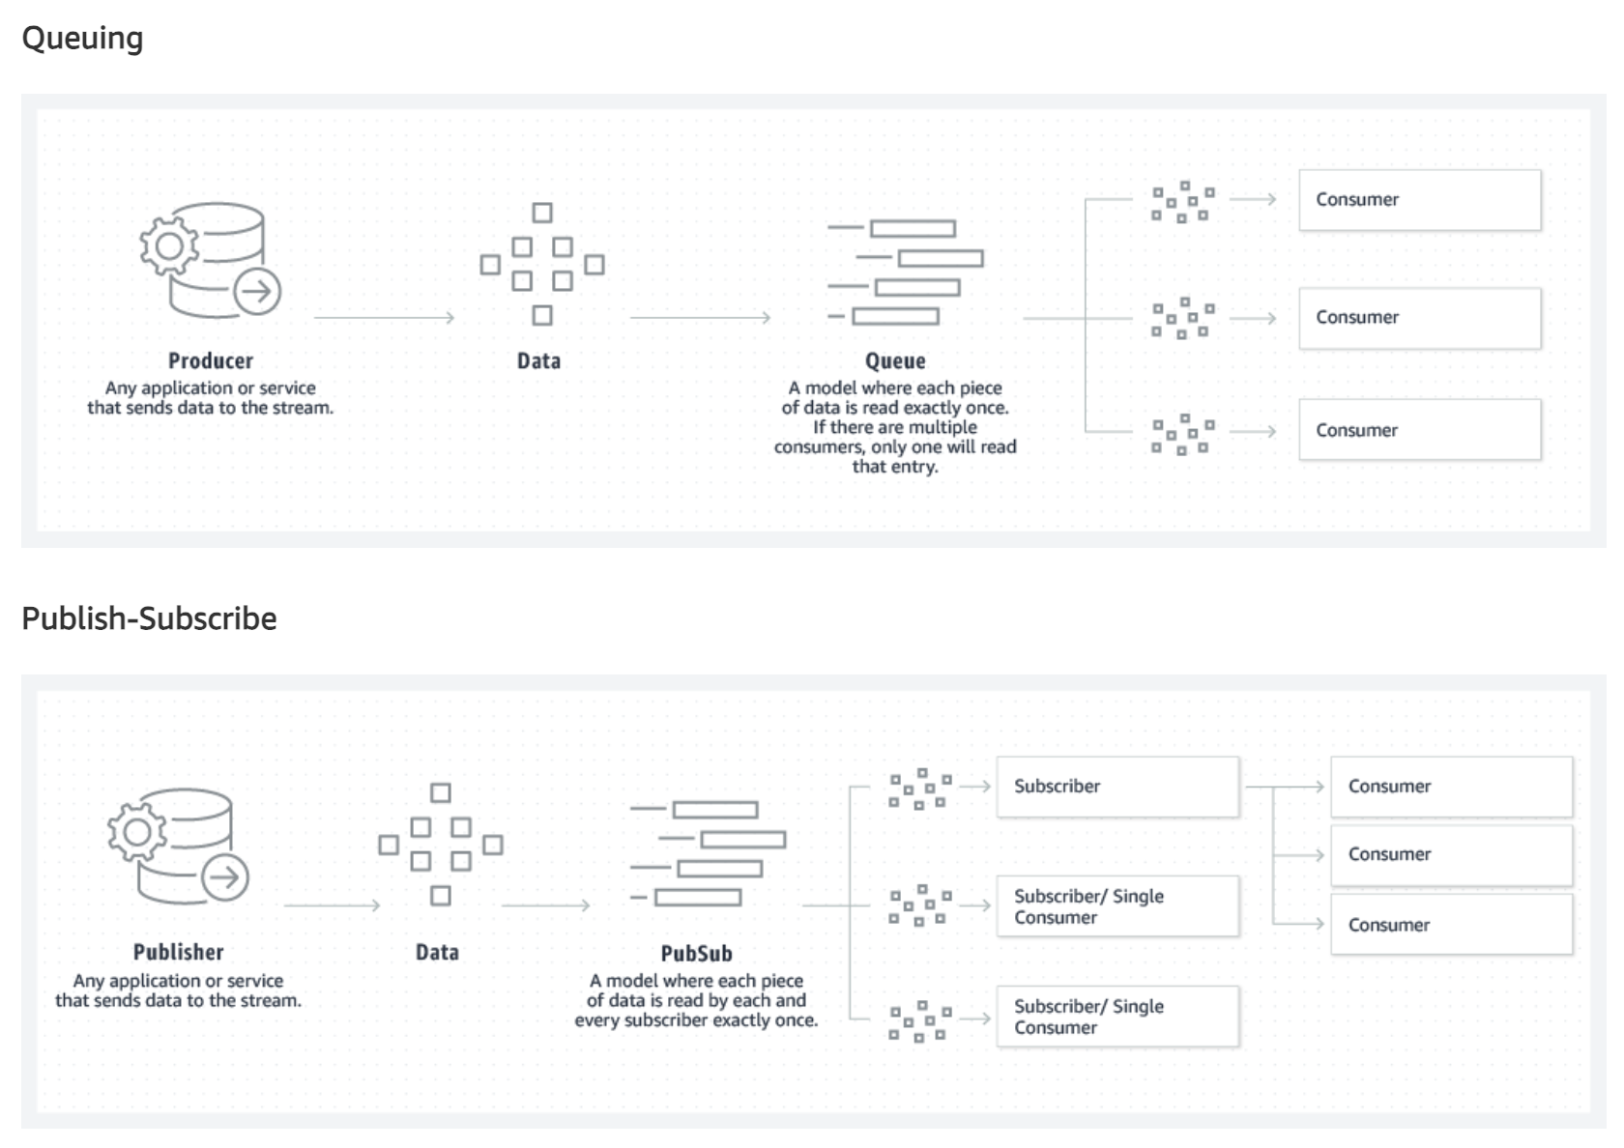
The flow
https://softwaremill.com/kafka-visualisation/

Slide 20


Kafka and other solution : messagerie system

Slide 21
Kafka vs other solutions : Cloud-Native Alternatives
Amazon Kinesis
Azure Event Hubs
Google Cloud Pub/Sub

Slide 22
Kafka & other solutions: analytics
Apache Flink
Apache Spark Streaming

Slide 23
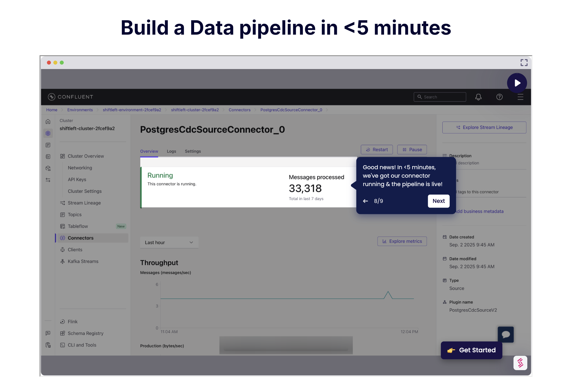
Confluent

Slide 24
TABLE
OF CONTENT
Introduction : a lot of code today
What is kafka ?
How to integrate it ?
Team work

Slide 25
Kafka use cases
Use Case: Real-Time Analytics & Dashboards
Scenario: Ingesting website clickstreams, application logs, and sensor data instantly.
Benefit: Providing business users with real-time visibility into key operational metrics (e.g., inventory levels, website traffic, application performance).
Example: Real-time monitoring of social media platform interactions (likes, shares) for instant trend analysis.
Use Case: Operational Monitoring & Fraud Detection
Scenario: Processing credit card transactions or banking activities.
Benefit: Analyzing event sequences in real-time to spot anomalous patterns indicative of fraud.
Mechanism: Kafka streams feed data instantly to a processing engine that flags suspicious activity within milliseconds.
Use Case: Log Aggregation
Scenario: Collecting log files and operational metrics from thousands of servers and applications globally.
Benefit: Centralizing all logs into a single, scalable stream before routing them to long-term storage (like a Data Lake or Elasticsearch).
Mechanism: Kafka handles the high volume and velocity, ensuring no log data is lost.
Use Case: Data Replication & CDC
Scenario: Capturing changes from operational databases (MySQL, PostgreSQL) in real-time.
Benefit: Feeding those incremental changes (Insert, Update, Delete) directly to the Data Warehouse or Data Lake for continuous, near-real-time updates.
Tool: Often achieved using specialized CDC tools that write directly to Kafka.

Slide 26
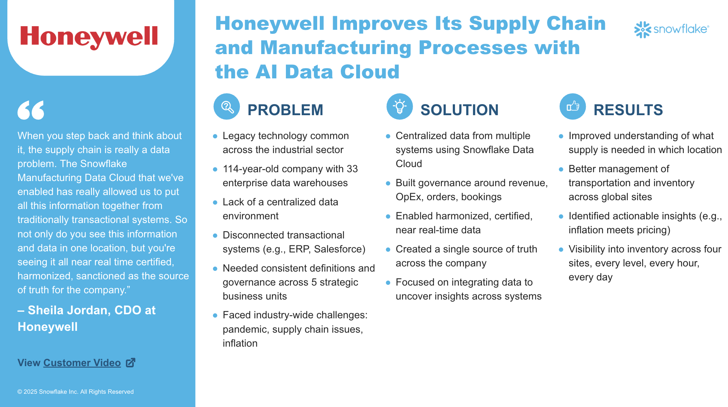

Slide 27
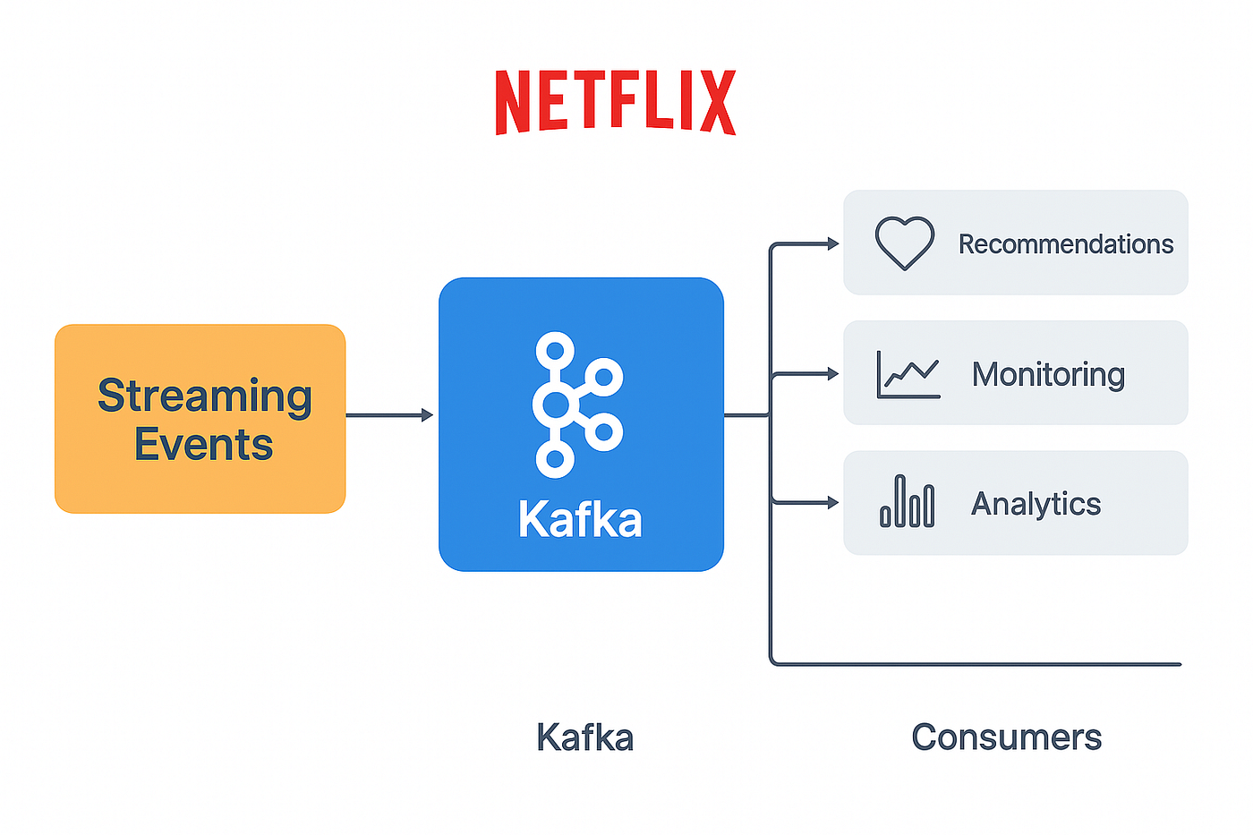
Kafka use cases

Slide 28
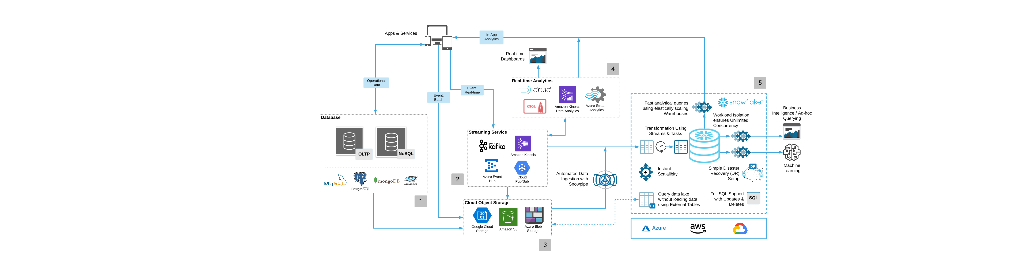
Kafka use cases

Slide 29
TABLE
OF CONTENT
Introduction : a lot of code today
What is kafka ?
How to integrate it ?
Team work

